Slide 1
The 2017 PPS Meeting

Slide 2
Welcome to Lisbon
Dear friends
We would like to invite you to the 63nd Annual Meeting of the Paediatric Pathology Society, which will be held in Lisbon, Portugal from the 7th to the 9th September 2017.
Lisbon s the capital and the largest city of Portugal, one of the oldest cities in the world, and the oldest in Western Europe, predating other modern European capitals such as London, Paris and Rome by centuries.
Situated at the mouth of the Tagus River, is the westernmost capital of a mainland European country.

Slide 3
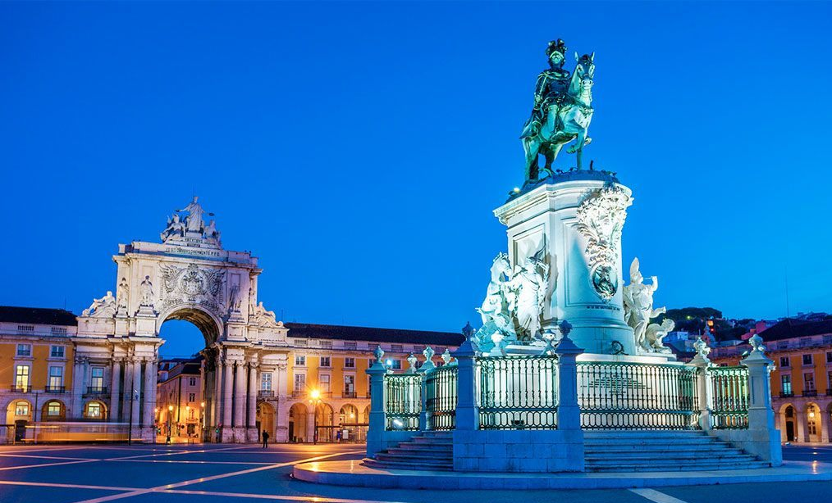
Welcome to Lisbon
Lisbon area offer exclusive characteristics:
Small city
Safe city
Hotels in a walking distance from venue
Gastronomy
Prices
People, Culture and History

Slide 4
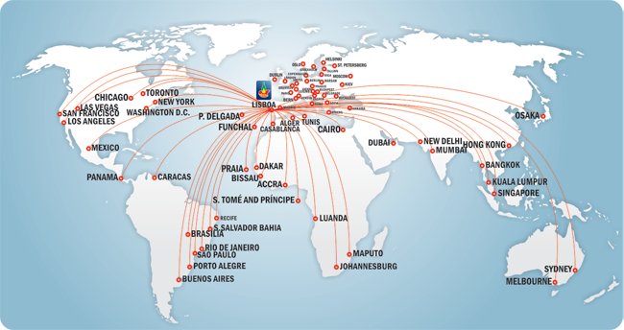
It is very easy to reach Lisbon

Slide 5
Airlines provinding services in Lisbon

Slide 6
Congress Venue – the new EXPO area Vip Executive Arts Hotel 4*
Accessibility:
2km from airport
Metro, taxi, bus and other public transports access
3, 4 and 5 star hotels nearby
Meeting rooms:
Auditorium: for 165 person
Extra room: exibithors and posters
Web: www.vip-executive-arts.hotel-rn.com

Slide 7
Congress Venue Vip Executive Arts Hotel 4*
Rooms:
Number of rooms 300
special price for congress attendes)

Slide 8
Hotels proximity - walking distance

Slide 9
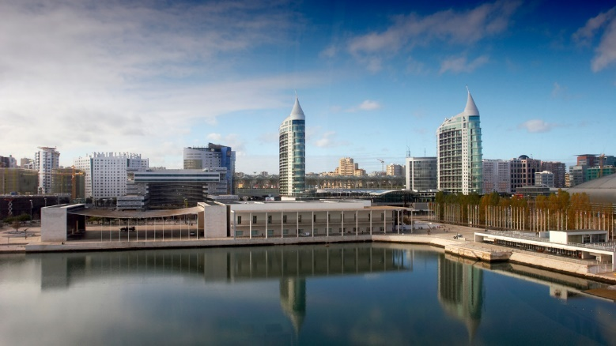
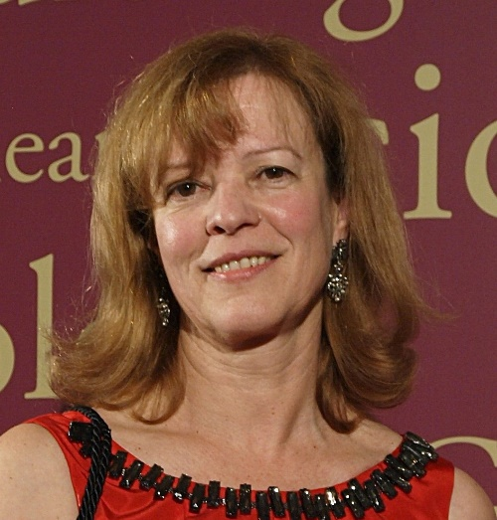
Looking forward to meeting you in Lisbon
Paula Borralho
FactorChave (PCO): Oficial Agency of the Portuguese Pathology Society

